Slide 1


Church Financial recordkeeping
by : MI4.

Slide 2
Overview
Introduction
Requirement of the application
Team organization
Design, Implementation, Test Report
Section 1
Problem encountered
Deviations
Problem remaining
Section 2
Future Work
Different ?
Functionality, Users, Deployment issues
Learned

Slide 3
Introduction
Main goal: To replace the existing system, with robust features to support the needs of secretary.
It is a financial recordkeeping application.
Our project maintains the donation made to a Church.
The application allows the user to enter the funds and print customized reports.

Slide 4
Purpose of the Application
Previous application -> Proposed Requirements -> Developed Requirements
It allows to add, delete the members at any time.
It allows to add, delete type of funds donated to church at any time.
It allows update for human errors.
The customized reports can be generated for different period of time.
We tried to develop a user friendly application.

Slide 5
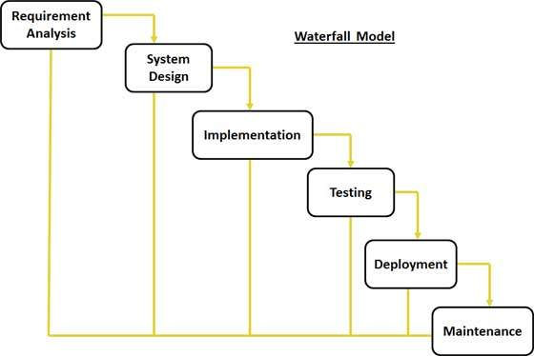



Team Organization
The team had a controlled decentralized structure.
Process Model : Water Fall Model.

Slide 6
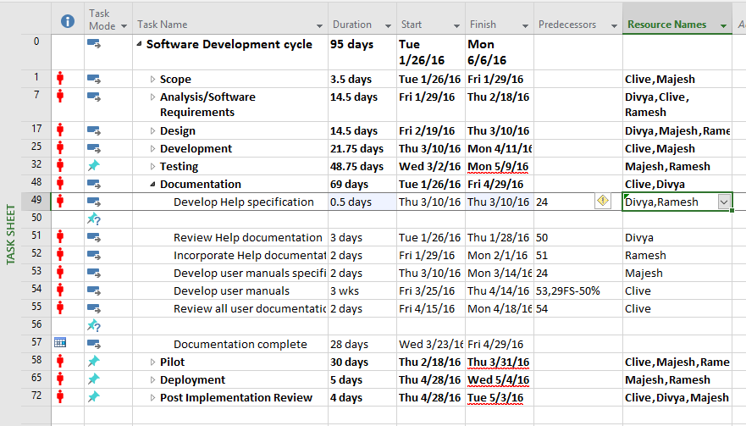
Task list
The following table shows the list of tasks identified in the project and executed.

Slide 7
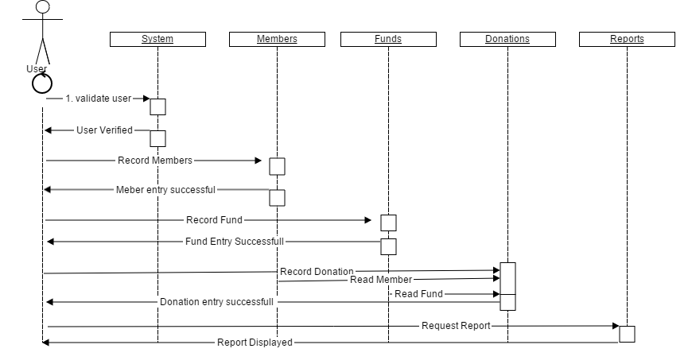
Design Diagram :Sequence Diagram
Sequence diagram

Slide 8
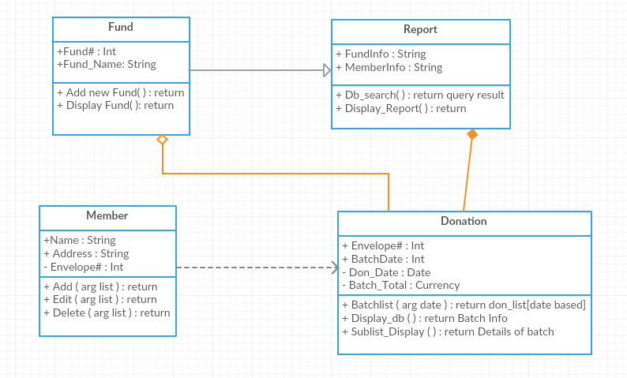
Design Diagram :Class
Class diagram

Slide 9
Test Report
The application has been tested from the implementation stages of the development
All the team members were involved in testing.
Acceptance testing was performed after finalizing the requirements.
Test cases are identified and executed.
Every functionality was implemented and tested for correctness.
All the functionalities implemented are integrated and tested.
Whole system is tested for usability- still being tested .

Slide 10
Challenges
Functional Issues
To populate and display the details in table(grid view).
To generate the report for print purpose(PDF).
To write the values to the database after editing.
Non-Functional Issues
Time problems with the team meeting and follow ups.
Time spent in Documenting the project.

Slide 11
Problems existing in the system
An alert message is not prompted after insertion, in ajax.
A redirection error in donation page, when inserting an envelope number not in database.
Existing record validation is required.
Calendar function is not available in Mozilla and IE browsers.

Slide 12
Future Works
To make project accessible to users from anywhere by deploying the application on a server.
The automated Email sending option can be implemented, to send emails that contain reports to the members on yearly basis.
To resolve account session problems in the browser.
To make application more browser supportive to utilize the good interface and functionalities.
Maybe for mobile interface.

Slide 13
Functionalities
The major functionalities of the proposed software are:
Login Page
Insert(Member, Fund, Donation )
Update(Member, Fund, Donation )
Delete(Member, Fund, Donation )
Search(Member, Fund, Donation )
Print custom reports

Slide 14
Client/Customer/User
The Church financial application is to be used by the church secretary.
Secretary uses the application to keep records of all the donations, and generate reports.
Prof. Cerise Wuthrich is our client and user of the system.

Slide 15
Deployment
System must have a browser.
The target system should have java installed and MySQL Database for application to run.
The system must have latest or up to date version of Acrobat reader for the reports.

Slide 16
Learned
Learned new languages and development environment like Java, JavaScript, MySQL, HTML, Ajax, and JQuery.
Learned new ideas in software engineering to successfully develop an application.
Importance of team work.

Slide 17
DEMO

Slide 18
References
McGraw, R. J. (2015, June 15). FOXMIS. Retrieved October 27, 2015,Google:http://community.mis.temple.edu/mis2101sec711summer2015/
Larman, C., Applying UML and Patterns: Introduction to Object-Oriented Analysis and Design and Iterative Development, 3rdedition (October 2004).
Somerville, I., Software Engineering 9th edition book, Pearson (March 2004).
Prof. Catherine V. Stringfellow.

Slide 19
Queries…??

Slide 20
Thank you!!!

